Slide 1

Chapter 1
The Context of Systems Analysis and Design Methods

Slide 2
Objectives
Define information system and name seven types of information system applications.
Identify different types of stakeholders who use or develop information systems, and give examples of each.
Define the unique role of systems analysts in the development of information systems.
Identify those skills needed to successfully function as an information system analyst.
Describe current business drivers that influence information systems development.
Describe current technology drivers that influence information systems development.
Briefly describe a simple process for developing information systems.

Slide 3
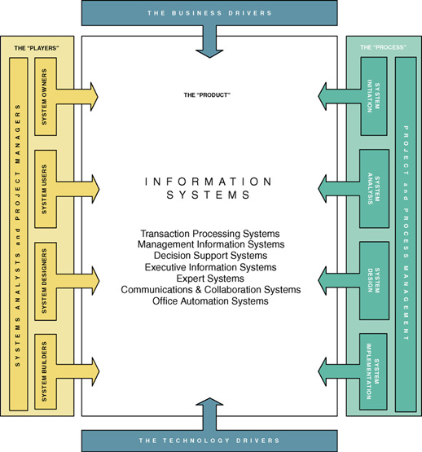

Slide 4
A Framework for Systems Analysis and Design
A system is a group of interrelated components that function together to achieve a desired result.
An information system (IS) is an arrangement of people, data, processes, and information technology that interact to collect, process, store, and provide as output the information needed to support an organization.
Information technology is a contemporary term that describes the combination of computer technology (hardware and software) with telecommunications technology (data, image, and voice networks).

Slide 5
Types of Information Systems
A transaction processing system (TPS) is an information system that captures and processes data about business transactions.
A management information system (MIS) is an information system that provides for management-oriented reporting based on transaction processing and operations of the organization.
A decision support system (DSS) is an information system that either helps to identify decision making opportunities or provides information to help make decisions.

Slide 6
Types of Information Systems (cont.)
An expert system is an information system that captures the expertise of workers and then simulates that expertise to the benefit of non-experts.
A communications and collaboration system is an information system that enables more effective communications between workers, partners, customers, and suppliers to enhance their ability to collaborate.
An office automation system is an information system that supports the wide range of business office activities that provide for improved work flow between workers.

Slide 7
Stakeholders: Players in the Systems Game
A stakeholder is any person who has an interest in an existing or proposed information system. Stakeholders can be technical or nontechnical workers. They may also include both internal and external workers.
Information workers are those workers whose jobs involve the creation, collection, processing, distribution, and use of information.
Knowledge workers are a subset of information workers whose responsibilities are based on a specialized body of knowledge.

Slide 8
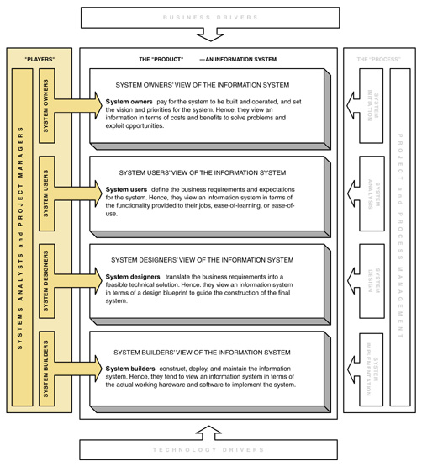
Stakeholders' Perspectives on an Information System

Slide 9
System Owners
System owners – an information system’s sponsor and executive advocate, usually responsible for funding the project of developing, operating, and maintaining the information system.

Slide 10
System Users
System users – a “customer” who will use or is affected by an information system on a regular basis – capturing, validating, entering, responding to, storing, and exchanging data and information.

Slide 11
Internal System Users
Clerical and service workers
Technical and professional staff
Supervisors, middle managers, and executive managers

Slide 12
External System Users
Customers
Suppliers
Partners
Employees
  Remote users - users who are not physically located on the premises but who still requires access to information systems.
  Mobile users - users whose location is constantly changing but who requires access to information systems from any location

Slide 13
System Designers and
System Builders
System designer – a technical specialist who translates system users’ business requirements and constraints into technical solution. She or he designs the computer databases, inputs, outputs, screens, networks, and software that will meet the system users’ requirements.
System builders – a technical specialist who constructs information systems and components based on the design specifications generated by the system designers.

Slide 14
Systems Analysts
Systems analyst – a specialist who studies the problems and needs of an organization to determine how people, data, processes, and information technology can best accomplish improvements for the business.
  A programmer/analyst (or analyst/programmer) includes the responsibilities of both the computer programmer and the systems analyst.
  A business analyst focuses on only the non-technical aspects of systems analysis and design.

Slide 15
The Systems Analyst as a Problem-Solver
By "Problems" that need solving, we mean:
  Problems, either real or anticipated, that require corrective action
  Opportunities to improve a situation despite the absence of complaints
  Directives to change a situation regardless of whether anyone has complained about the current situation

Slide 16
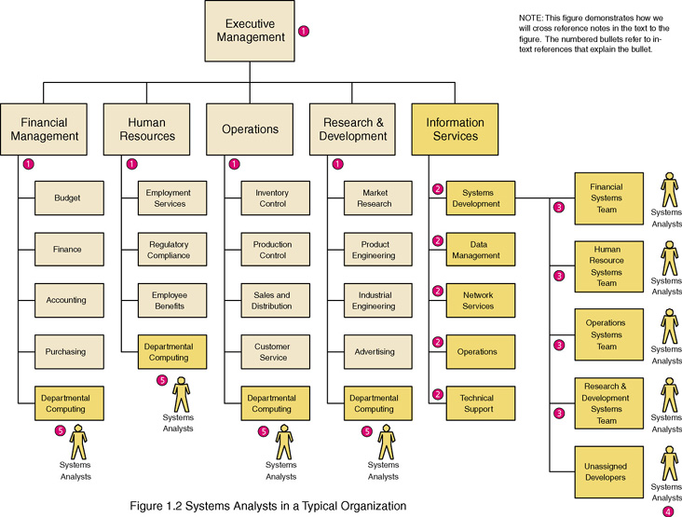
Where Do Systems Analysts Work?

Slide 17
Skills Needed by the Systems Analyst
Working knowledge of information technology
Computer programming experience and expertise
General business knowledge
General problem-solving skills
Good interpersonal communication skills
Good interpersonal relations skills
Flexibility and adaptability
Character and ethics

Slide 18
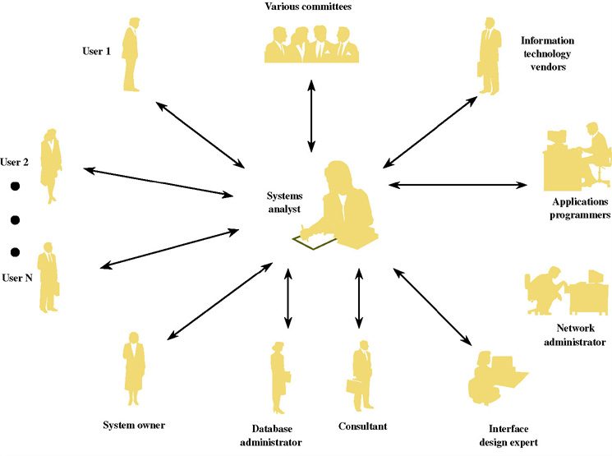
The Systems Analyst as a Facilitator

Slide 19
The Ten Commandments of Computer Ethics
1. Thou shalt not use a computer to harm other people.
2. Thou shalt not interfere with other people’s computer work.
3. Thou shalt not snoop around in other people’s computer files.
4. Thou shalt not use a computer to steal.
5. Thou shalt not use a computer to bear false witness.
6. Thou shalt not copy or use proprietary software for which you have not paid.
7. Thou shalt not use other people’s computer resources without authorization or proper compensation.
8. Thou shalt not appropriate other people’s intellectual output.
9. Thou shalt think about the social consequences of the program you are writing or the system you are designing.
10. Thou shalt always use a computer in ways that insure consideration and respect for your fellow human
Source: Computer Ethics Institute

Slide 20
Other Stakeholders
External Service Provider (ESP) – a systems analyst, system designer, or system builder who sells his or her expertise and experience to other businesses to help those businesses purchase, develop, or integrate their information systems solutions; may be affiliated with a consulting or services organization.
Project Manager – an experienced professional who accepts responsibility for planning, monitoring, and controlling projects with respect to schedule, budget, deliverables, customer satisfaction, technical standards, and system quality.

Slide 21
Business Drivers for Today’s Information Systems
Globalization of the Economy
Electronic Commerce and Business
Security and Privacy
Collaboration and Partnership
Knowledge Asset Management
Continuous Improvement and Total Quality Management
Business Process Redesign

Slide 22
Globalization of the Economy
Global Economy brings
  New and expanded international markets
  New international competitors
Impact on information systems
  Require support of multiple languages, currency exchange rates, business cultures
  Require consolidation of international data
  Demand for players who can communicate, orally and in writing, with management and users that speak different languages

Slide 23
Electronic Commerce and Business
E-Commerce – the buying and selling of goods and services by using the Internet.
E-Business – the use of the Internet to conduct and support day-to-day business activities.
Types of e-commerce and e-business
  Marketing of corporate image, products, and services
  Business-to-consumer (B2C)
  Business-to-business (B2B)
Impact on information systems
  Most new information systems are being designed for an Internet (or intranet) architecture
  Since the only client-side software is a web browser, the choice of client operating system is becoming less important

Slide 24
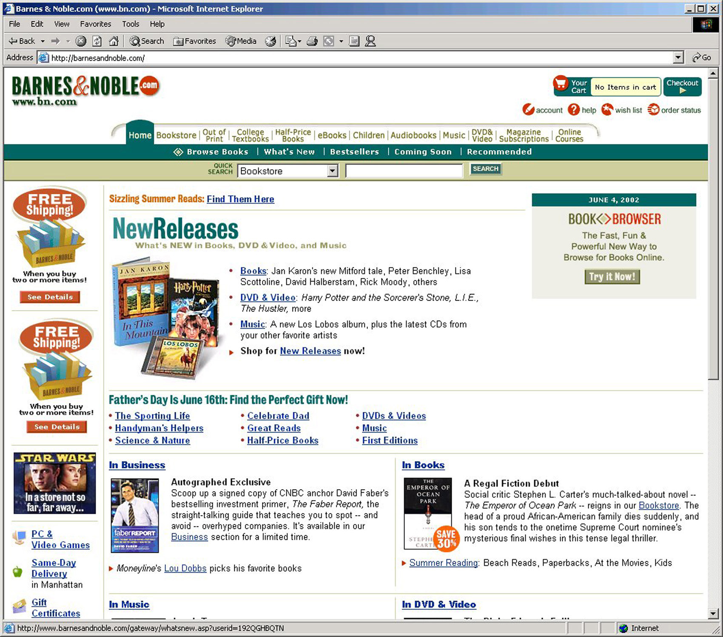
An Electronic Commerce Storefront

Slide 25
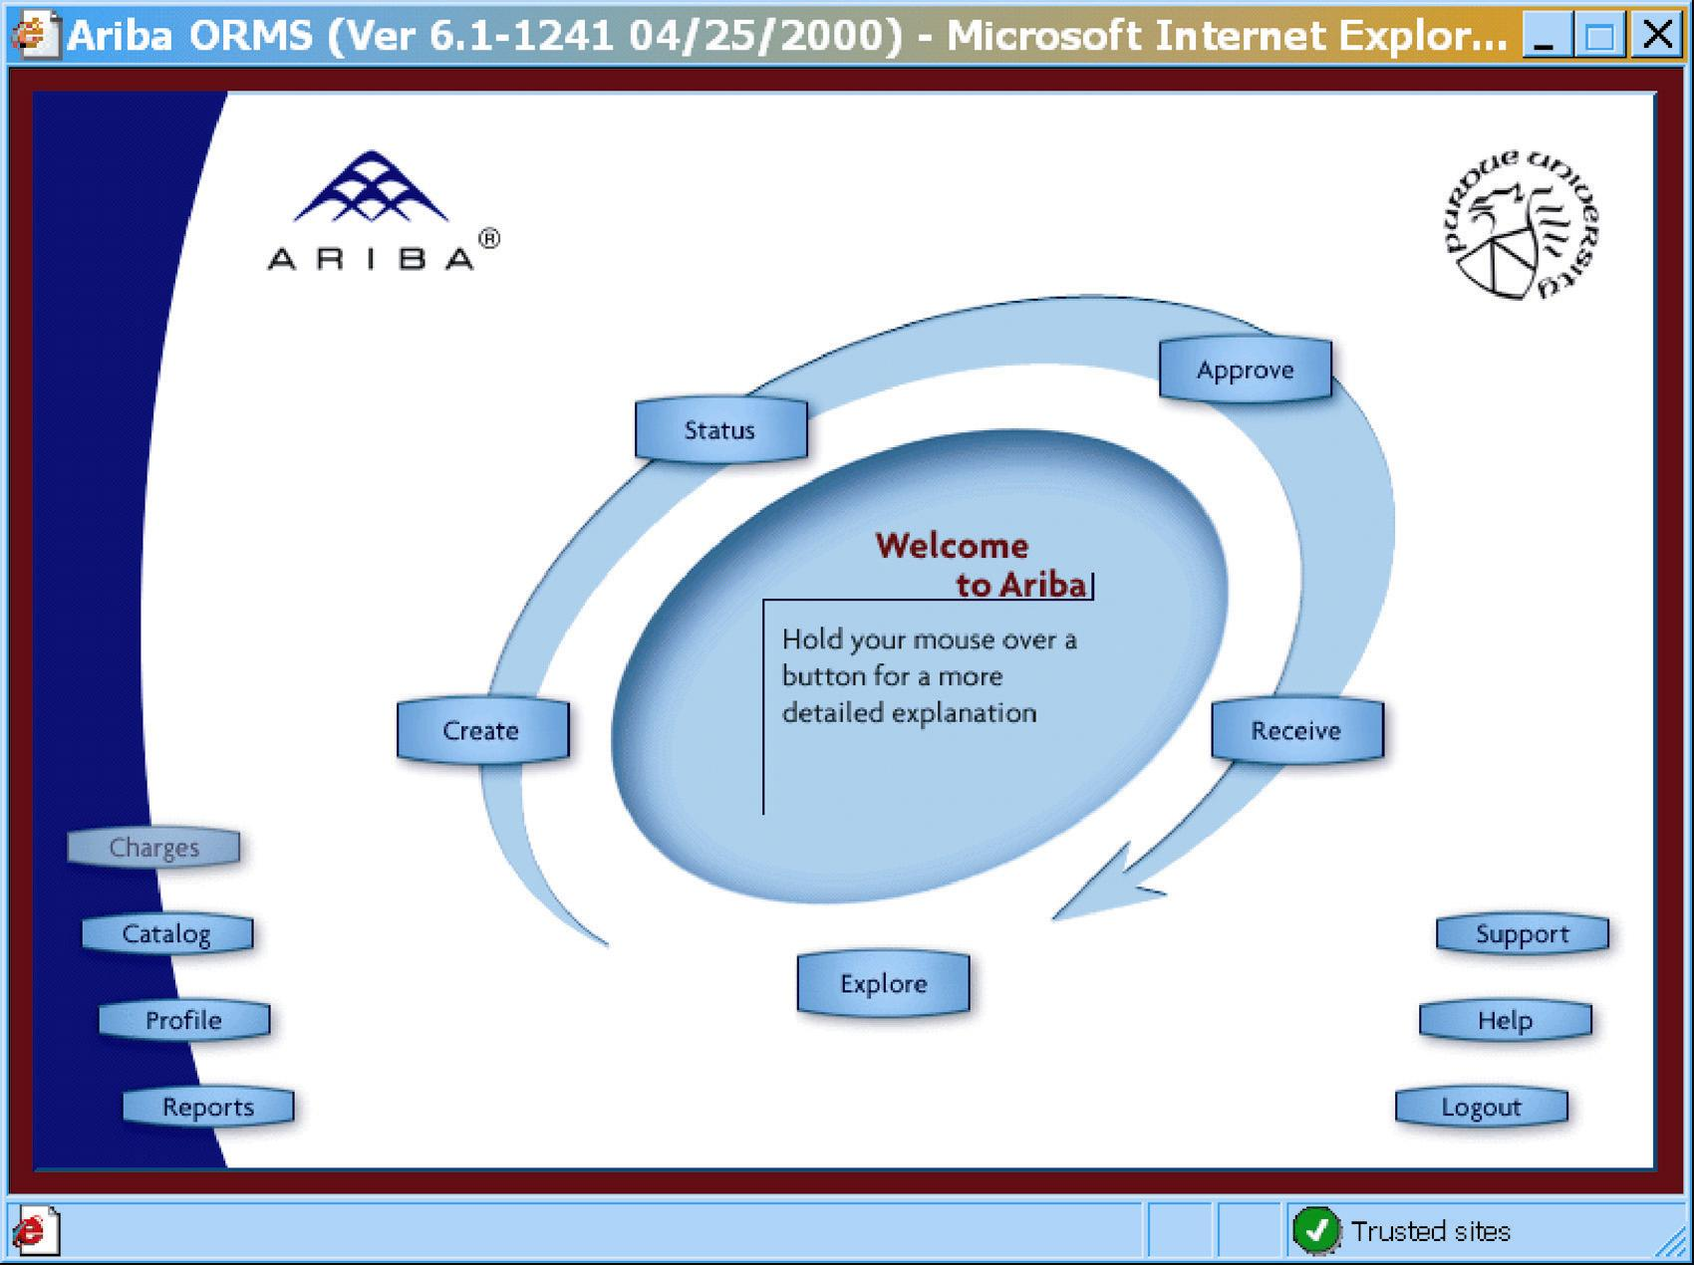
An Electronic Commerce Procurement Storefront

Slide 26
Security and Privacy
Security
  How will the business continue in the even of a security breach, terrorist attack, or disaster?
  How can the business protect its digital assets from outside threats?
Privacy
  Consumer demands for privacy in e-commerce transactions
  Government requirements
Impact on information systems
  Need to incorporate stringent security and privacy controls

Slide 27
Collaboration and Partnership
Organizations seek to break down the walls that separate organizational departments and functions.
Organizations collaborate with outside business partners and even competitors.
Impact on information systems
  Need to provide secure, external access
  Need to pass data between different information systems

Slide 28
Knowledge Asset Management
Data – raw facts about people, places, events, and things that are of importance in an organization.
Information – data that has been processed or reorganized into a more meaningful form for someone.
Knowledge – data and information that is further refined based on the facts, truths, beliefs, judgments, experiences, and expertise of the recipient.
Knowledge Asset Management
  Recognizes that data, information, and knowledge are critical business resources
  Asks: “How can the organization manage and share knowledge for competitive advantage?”
  Strives to integrate the data and information that can create and preserve knowledge

Slide 29
Continuous Improvement and
Total Quality Management
Business Processes – Tasks that respond to business events (e.g., an order). Business processes are the work, procedures, and rules required to complete the business tasks, independent of any information technology used to automate or support them.
Continuous process improvement (CPI) – The continuous monitoring of business processes to effect small but measurable improvements in cost reduction and value added.
Total quality management (TQM) – a comprehensive approach to facilitating quality improvements and management within a business.

Slide 30
Business Process Redesign
Business process redesign (BPR) is the study, analysis, and redesign of fundamental business processes to reduce costs and/or improve value added to the business.
  More substantial changes and improvements than CPI
  Usually complemented by CPI

Slide 31
Technology Drivers for Today’s Information Systems
Networks and the Internet
Mobile and Wireless Technologies
Object Technologies
Collaborative Technologies
Enterprise Applications

Slide 32
Networks and the Internet
Networks include mainframe time-sharing systems, network servers, and a variety of desktop, laptop, and handheld client computers.
The most pervasive networking technologies are based on the Internet.
  XHTML and XML
  Scripting languages
  Web-specific programming languages
  Intranets
  Extranets
  Portals
  Web services

Slide 33

Mobile and Wireless Technologies
Some mobile and wireless technologies
  PDAs
  Smart phones
  Bluetooth
  Wireless networking
Impact on information systems
  Wireless connectivity must be
  assumed
  Limitations of mobile devices
  and screen sizes must be accommodated

Slide 34
Object Technologies
Object technology – a software technology that defines a system in terms of objects that consolidate data and behavior (into objects).
  Objects are reusable
  Objects are extensible
  Object-oriented programming languages include C++, Java, Smalltalk, and .NET
Object-oriented analysis and design – a collection of tools and techniques for systems development that will utilize object technologies to construct a system and its software.
Agile development – a system development strategy in which system developers are given the flexibility to select from a variety of tools and techniques to best accomplish the tasks at hand.

Slide 35
Collaborative Technologies
Collaborate technologies are those that enhance interpersonal communications and teamwork.
  E-mail
  Instant messaging
  Groupware
  Work flow

Slide 36
Enterprise Applications
Virtually all organizations require a core set of enterprise applications
  Financial mgmt, human resources, sales, etc.
  Frequently purchased
  Frequently need to have custom elements added
Systems Integration - the process of building a unified information system out of diverse components of purchases software, custom-built software, hardware, and networking.

Slide 37
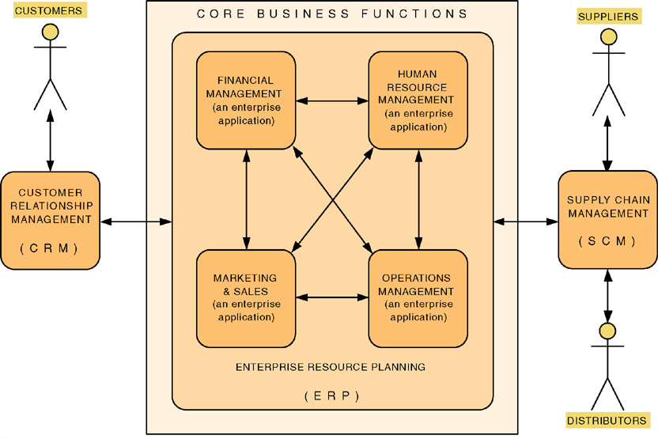
Enterprise Applications

Slide 38
Enterprise Applications - ERP
Enterprise Resource Planning (ERP) – a software application that fully integrates information systems that span most or all of the basic, core business functions.
An ERP solution is built around a common database shared by common business functions.
Representative ERP vendors:
  SSA
  Oracle/Peoplesoft
  SAP AG

Slide 39
Enterprise Applications - SCM
Supply Chain Management (SCM) – a software application that optimizes business processes for raw material procurement through finished product distribution by directly integrating the logistical information systems of organizations with those of their suppliers and distributors.
Representative SCM vendors:
  i2 Technologies
  Manugistics
  SAP
  SCT

Slide 40
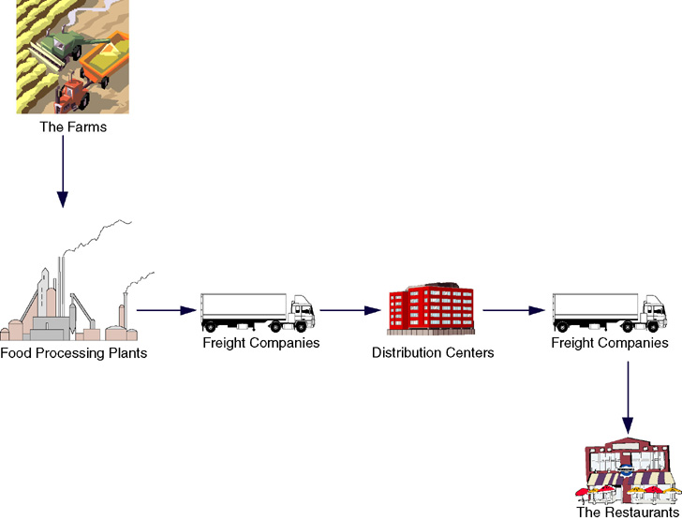
Supply Chain

Slide 41
Enterprise Applications - CRM
Customer Relationship Management (CRM) – a software application that provides customers with access to a business’s processes from initial inquiry through postsale service and support.
Representative CRM vendors:
  SAP
  BroadVision
  E.piphany
  Kana
  Amdocs
  Oracle/Peoplesoft
  Siebel

Slide 42
Enterprise Applications - EAI
Enterprise Application Integration (EAI) – the process and technologies used to link applications to support the flow of data and information between those applications.
Middleware – software (usually purchased) used to translate and route data between different applications.
Representative EAI vendors:
  BEA Systems
  IBM (MQSeries)
  Mercator Software
  TIBCO Software

Slide 43
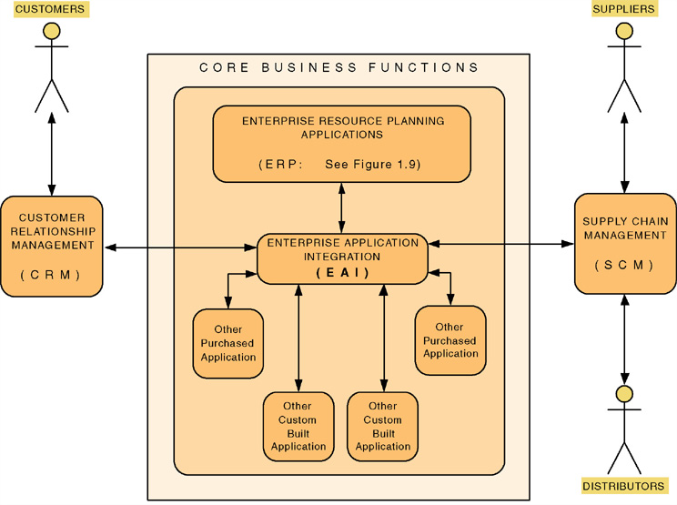
Enterprise Application Integration

Slide 44
System Development Process
System development process – a set of activities, methods, best practices, deliverables, and automated tools that stakeholders use to develop and maintain information systems and software.
A general problem-solving approach
  Identify the problem.
  Analyze and understand the problem.
  Identify solution requirements or expectations.
  Identify alternative solutions and choose the “best” course of action.
  Design the chosen solution.
  Implement the chosen solution.
  Evaluate the results. If the problem is not solved, return to step 1 or 2 as appropriate.

Slide 45
A Simple System
Development Process
Our Simplified System Development Process | General Problem-Solving Steps
System initiation | Identify the problem.
System analysis | Analyze and understand the problem. Identify solution requirements or expectations.
System design | Identify alternative solutions and choose the “best” course of action. Design the chosen solution.
System implementation | Implement the chosen solution. Evaluate the results. If the problem is not solved, return to step 1 or 2 as appropriate.

Slide 46
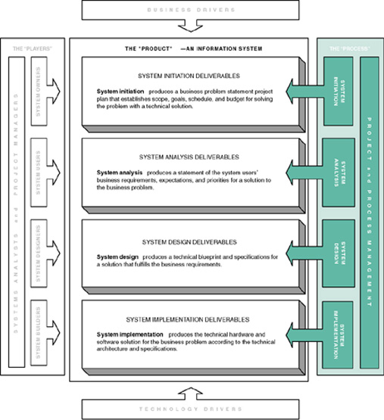
Systems Development Process Overview

Slide 47
System Development Process Overview
System initiation – the initial planning for a project to define initial business scope, goals, schedule, and budget.
System analysis – the study of a business problem domain to recommend improvements and specify the business requirements and priorities for the solution.
System design – the specification or construction of a technical, computer-based solution for the business requirements identified in a system analysis.
System implementation – the construction, installation, testing, and delivery of a system into production.

Slide 48
Project and Process Management
Project management – the activity of defining, planning, directing, monitoring, and controlling a project to develop an acceptable system within the allotted time and budget.
Process management – the ongoing activity that defines, improves, and coordinates the use of an organization’s chosen methodology (the “process”) and standards for all system development projects.

